Slide 1
System Programming and Compiler Construction (Course Code - CE61) Lecture #12
Dr. Anant V Nimkar PhD(CSE-IIT Kharagpur)
Associate Professor
Department of Computer Engineering
Sardar Patel Institute of Technology Mumbai

Slide 2
Bottom-Up Parsing
Bottom-Up Parsing
Shift-Reduce Parsing
Operator Precedence Parsing
LR Parsers
Simple LR Parser
Canonical LR Parser
Lookahead LR Parser

Slide 3
Classification of parsing methods
Parsing
Top down parsing
Bottom up parsing (Shift reduce)
Back tracking
Operator precedence
Parsing without backtracking (predictive Parsing)
LR parsing
SLR
LL(1)
CLR
Recursive
descent
LALR

Slide 4
Handle & Handle pruning
Handle: A “handle” of a string is a substring of the string that matches the right side of a production, and whose reduction to the non terminal of the production is one step along the reverse of rightmost derivation.
Handle pruning: The process of discovering a handle and reducing it to appropriate left hand side non terminal is known as handle pruning.
E→E+E
E→E*E
E→id
String: id1+id2*id3
Right sentential form | Handle | Production
Rightmost Derivation
E
E+E
E+E*E
E+E*id3
E+id2*id3
id1+id2*id3
id1+id2*id3 | id1 | E→id
E+id2*id3 | id2 | E→id
E+E*id3 | id3 | E→id
E+E*E | E*E | E→E*E
E+E | E+E | E→E+E
E

Slide 5
Exercise
S→aABe
A→Abc | b
B→d
String: abbcde

Slide 6
Shift reduce parser
The shift reduce parser performs following basic operations:
Shift: Moving of the symbols from input buffer onto the stack, this action is called shift.
Reduce: If handle appears on the top of the stack then reduction of it by appropriate rule is done. This action is called reduce action.
Accept: If stack contains start symbol only and input buffer is empty at the same time then that action is called accept.
Error: A situation in which parser cannot either shift or reduce the symbols, it cannot even perform accept action then it is called error action.

Slide 7
Example: Shift reduce parser
Grammar:
E→E+T | T
T→T*F | F
F→id
String: id+id*id
Stack | Input Buffer | Action
$ | id+id*id$ | Shift
$
Id+id*id$
Shift
$id | +id*id$ | Reduce F→id
$F | +id*id$ | Reduce T→F
$T | +id*id$ | Reduce E→T
$E | +id*id$ | Shift
$E+ | id*id$ | Shift
$E+id | *id$ | Reduce F→id
$E+F | *id$ | Reduce T→F
$E+T | *id$ | Shift
$E+T* | id$ | Shift
$E+T*id | $ | Reduce F→id
$E+T*F | $ | Reduce T→T*F
$E+T | $ | Reduce E→E+T
$E | $ | Accept

Slide 8
Viable Prefix
The set of prefixes of right sentential forms that can appear on the stack of a shift-reduce parser are called viable prefixes.

Slide 9
Parsing methods
Parsing
Top down parsing
Bottom up parsing (Shift reduce)
Back tracking
Operator precedence
Parsing without backtracking (predictive Parsing)
LR parsing
SLR
LL(1)
CLR
Recursive
descent
LALR

Slide 10
Operator precedence parsing
Operator Grammar: A Grammar in which there is no Є in RHS of any production or no adjacent non-terminals is called operator grammar.
Example: E→ EAE | (E) | id
A→ + | * | -
Above grammar is not operator grammar because right side EAE has consecutive non terminals.
In operator precedence parsing we define following disjoint relations:
Relation | Meaning
a<.b | a “yields precedence to” b
.
a=b | a “has the same precedence as” b
a.>b | a “takes precedence over” b

Slide 11
Precedence & associativity of operators
Operator | Precedence | Associative
↑ | 1 | right
*, / | 2 | left
+, - | 3 | left

Slide 12
Steps of operator precedence parsing
Find Leading and trailing of non terminal
Establish relation
Creation of table
Parse the string

Slide 13
Leading & Trailing
Leading:- Leading of a non terminal is the first terminal or operator in production of that non terminal.
Trailing:- Trailing of a non terminal is the last terminal or operator in production of that non terminal.
Example: E→E+T | T
T→T*F | F
F→id
https://www.youtube.com/watch?v=AJ3pz70nN_o
Non terminal | Leading | Trailing
E | {+,*,id} | {+,*,id}
T | {*,id} | {*,id}
F | {id} | {id}

Slide 14
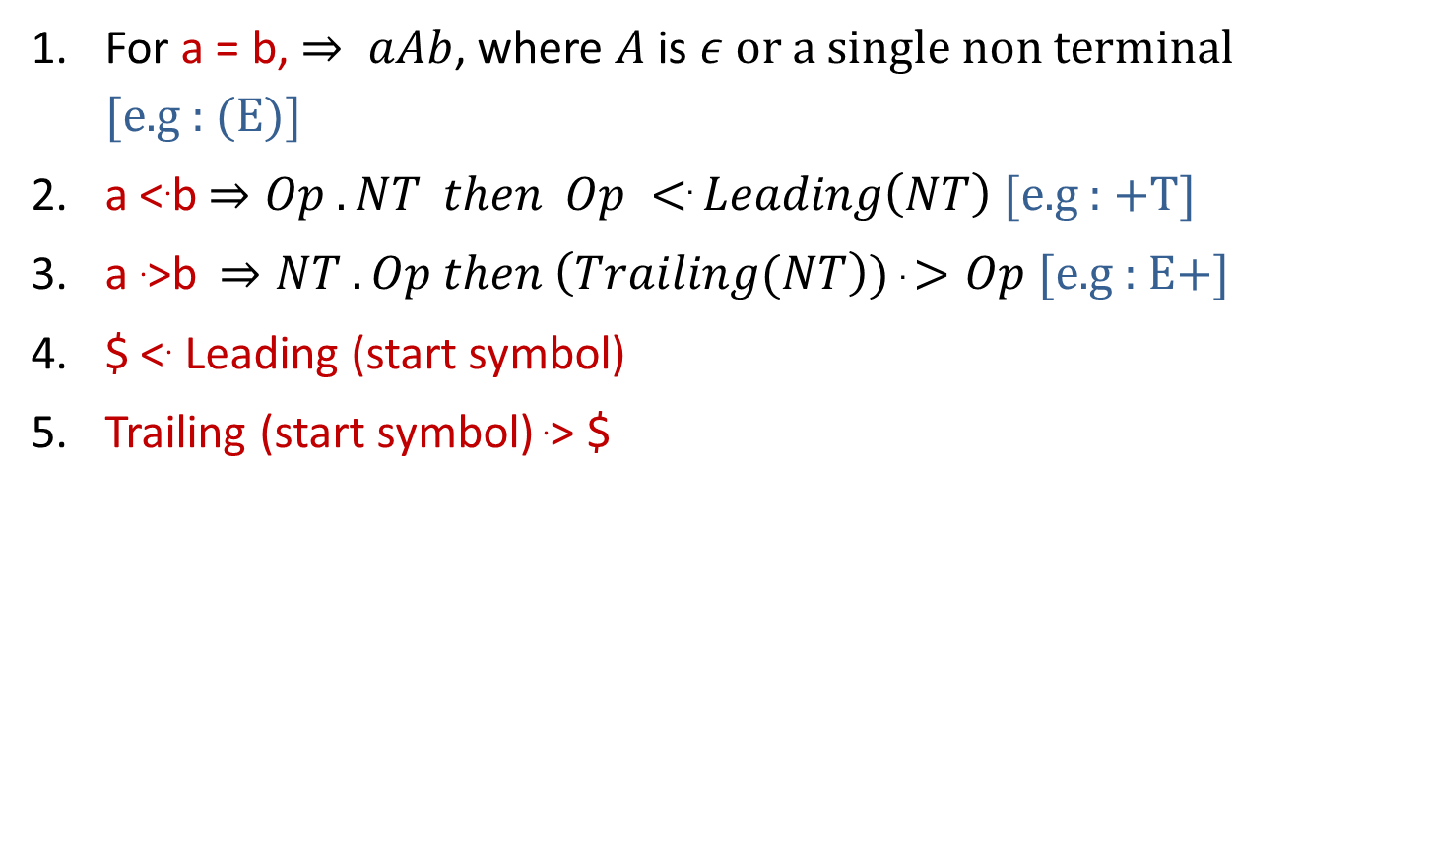
Rules to establish a relation
For a = b, $⇒ aAb$, where $A$ is $ε$ or a single non terminal [e.g : (E)]
a <.b$⇒Op .NT then Op <. Leading\left(NT\right)$[e.g : +T]
a .>b$⇒NT . Op then \left(Trailing(NT\right)) .>Op$[e.g : E+]
$ <. Leading (start symbol)
Trailing (start symbol) .> $
.

Slide 15

Example: Operator precedence parsing
a <.b
$Op .NT Op <. Leading\left(NT\right)$
$+T + <. \left\{∗,id\right\}$
$∗F ∗ <. \{id\}$
Step 1: Find Leading & Trailing of NT
E→ E
+T
| T
Nonterminal | Leading | Trailing
T→ T
| F
*F
E | {+,*,id} | {+,*,id}
F→ id
T | {*,id} | {*,id}
F | {id} | {id}
Step 2: Establish Relation
Step3: Creation of Table
 | + | * | id | $
+ | .> | <. | <. | .>
* | .> | .> | <. | .>
id | .> | .> |  | .>
$ | <. | <. | <.

Slide 16

Example: Operator precedence parsing
a .>b
$NT . Op \left(Trailing(NT\right)).>Op$
$E+ \left\{+,∗,id\right\}.> +$
$T∗ \{∗,id\}.>∗$
Step 1: Find Leading & Trailing of NT
E→
E+
T| T
Nonterminal | Leading | Trailing
T→
F| F
T*
E | {+,*,id} | {+,*,id}
F→ id
T | {*,id} | {*,id}
F | {id} | {id}
Step2: Establish Relation
Step3: Creation of Table
 | + | * | id | $
+ | .> | <. | <. | .>
* | .> | .> | <. | .>
id | .> | .> |  | .>
$ | <. | <. | <.

Slide 17

Example: Operator precedence parsing
$<. Leading (start symbol)
$ <.$\left\{+,∗,id\right\}$
Trailing (start symbol).> $
$\left\{+,∗,id\right\} \text{.}\text{>} \text{\$}$
Step 1: Find Leading & Trailing of NT
E→
E+
T| T
Nonterminal | Leading | Trailing
T→
F| F
T*
E | {+,*,id} | {+,*,id}
F→ id
T | {*,id} | {*,id}
F | {id} | {id}
Step 3: Creation of Table
Step 2: Establish Relation
 | + | * | id | $
+ | .> | <. | <. | .>
* | .> | .> | <. | .>
id | .> | .> |  | .>
$ | <. | <. | <.

Slide 18
Example: Operator precedence parsing
Assign precedence operator between terminals
String: id+id*id
$ id+id*id $
$ <. id+id*id$
$ <. id .> +id*id$
$ <. id .> + <. id*id$
$ <. id .> + <. id .> *id$
$ <. id .> + <. id .> *<. id$
$ <. id .> + <. id .> *<. id .> $
Step 4: Parse the string using precedence table
 | + | * | id | $
+ | .> | <. | <. | .>
* | .> | .> | <. | .>
id | .> | .> |  | .>
$ | <. | <. | <.

Slide 19
Example: Operator precedence parsing
Step 4: Parse the string using precedence table
Scan the input string until first .> is encountered.
Scan backward until <. is encountered.
The handle is string between <. and .>
$ <. Id .> + <. Id .> * <. Id .> $ | Handle id is obtained between <. and .> Reduce this by F→id
$ F + <. Id .> * <. Id .> $ | Handle id is obtained between <. and .> Reduce this by F→id
$ F + F * <. Id .> $ | Handle id is obtained between <. and .> Reduce this by F→id
$ F + F * F $ | Perform appropriate reductions of all nonterminals.
$ E + T * F $ | Remove all non terminals.
$ + * $ | Place relation between operators
$ <. + <. * >$ | The * operator is surrounded by <. and .>. This indicates * becomes handle so reduce by T→T*F.
$ <. + >$ | + becomes handle. Hence reduce by E→E+T.
$ $ | Parsing Done

Slide 20
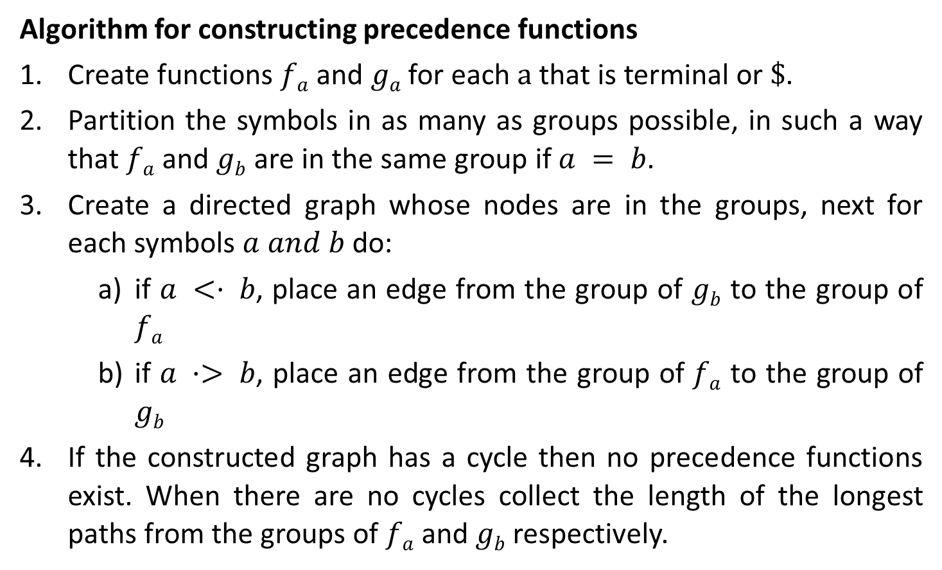
Operator precedence function
Algorithm for constructing precedence functions
Create functions $fa$ and $ga$ for each $a$ that is terminal or $\$$.
Partition the symbols in as many as groups possible, in such a way that $fa$ and $gb$ are in the same group if $a = b$.
Create a directed graph whose nodes are in the groups, next for each symbols $a and b$do:
if $a <· b$, place an edge from the group of $gb$ to the group of $fa$
if $a ·> b$, place an edge from the group of $fa$ to the group of $gb$
If the constructed graph has a cycle then no precedence functions exist. When there are no cycles collect the length of the longest paths from the groups of $fa$ and $gb$respectively.
.

Slide 21

Operator precedence function
Create functions f_{a} and g_{a} for each a that is terminal or $.
$a= \{+,∗,id\} or \$$
E→ E+T | T
T→ T*F | F F→ id
f₊
f*
f_{id}
f$
g₊
g*
g_{id}
g$

Slide 22
Operator precedence function
Partition the symbols in as many as groups possible, in such a way that f_{a} and g_{b} are in the same group if a = b.
.
 | + | * | id | $
g_{id}
f_{id}
+ | .> | <. | <. | .>
* | .> | .> | <. | .>
id | .> | .> |  | .>
$ | <. | <. | <.
f*
g*
g₊
f₊
f$
g$

Slide 23
Operator precedence function
if a <· b, place an edge from the group of g_{b} to the group of f_{a}
if a ·> b, place an edge from the group of f_{a} to the group of g_{b}
g
f
 | + | * | id | $
g_{id}
f_{id}
+ | .> | <. | <. | .>
* | .> | .> | <. | .>
id | .> | .> |  | .>
$ | <. | <. | <.
f*
g*
g₊
f₊
f₊ .> g₊
f₊ → g₊
f* .> g₊
f* → g₊
f_{id} .> g₊
f_{id} → g₊
f$
g$
f$ <. g₊
f$ ← g₊

Slide 24
Operator precedence function
if a <· b, place an edge from the group of g_{b} to the group of f_{a}
if a ·> b, place an edge from the group of f_{a} to the group of g_{b}
g
f
 | + | * | id | $
g_{id}
f_{id}
+ | .> | <. | <. | .>
* | .> | .> | <. | .>
id | .> | .> |  | .>
$ | <. | <. | <.
f*
g*
g₊
f₊
f₊ <. g*
f₊ ← g*
f* .> g*
f* → g*
f_{id} .> g*
f_{id} → g*
f$
g$
f$ <. g*
f$ ← g*

Slide 25
Operator precedence function
if a <· b, place an edge from the group of g_{b} to the group of f_{a}
if a ·> b, place an edge from the group of f_{a} to the group of g_{b}
g
f
 | + | * | id | $
g_{id}
f_{id}
+ | .> | <. | <. | .>
* | .> | .> | <. | .>
id | .> | .> |  | .>
$ | <. | <. | <.
f*
g*
g₊
f₊
f₊ <. g_{id}
f₊ ← g_{id}
f* <. g_{id}
f* ← g_{id}
f$ <. g_{id}
f$ ← g_{id}
f$
g$

Slide 26
Operator precedence function
if a <· b, place an edge from the group of g_{b} to the group of f_{a}
if a ·> b, place an edge from the group of f_{a} to the group of g_{b}
g
f
 | + | * | id | $
g_{id}
f_{id}
+ | .> | <. | <. | .>
* | .> | .> | <. | .>
id | .> | .> |  | .>
$ | <. | <. | <.
f*
g*
g₊
f₊
f₊ <. g$
f₊ → g$
f* <. g$
f* → g$
f_{id} <. g$
f_{id} → g$
f$
g$

Slide 27
Operator precedence function
 | + | * | id | $
g_{id}
f_{id}
f | 2
g
f*
g*
If the constructed graph has a cycle then no precedence functions exist. When there are no cycles collect the length of the longest paths from the groups of f_{a} and g_{b} respectively.
g₊
f₊
f$
g$

Slide 28
Operator precedence function
 | + | * | id | $
g_{id}
f_{id}
f | 2
g | 1
f*
g*
g₊
f₊
f$
g$

Slide 29
Operator precedence function
 | + | * | id | $
g_{id}
f_{id}
f | 2 | 4
g | 1
f*
g*
g₊
f₊
f$
g$

Slide 30
Operator precedence function
 | + | * | id | $
g_{id}
f_{id}
f | 2 | 4
g | 1 | 3
f*
g*
g₊
f₊
f$
g$

Slide 31
Operator precedence function
 | + | * | id | $
g_{id}
f_{id}
f | 2 | 4 | 4
g | 1 | 3
f*
g*
g₊
f₊
f$
g$

Slide 32
Operator precedence function
 | + | * | id | $
g_{id}
f_{id}
f | 2 | 4 | 4
g | 1 | 3 | 5
f*
g*
g₊
f₊
f$
g$

Slide 33
Operator precedence function
 | + | * | id | $
g_{id}
f_{id}
f | 2 | 4 | 4 | 0
g | 1 | 3 | 5 | 0
f*
g*
g₊
f₊
f$
g$

Slide 34


